Slide 1

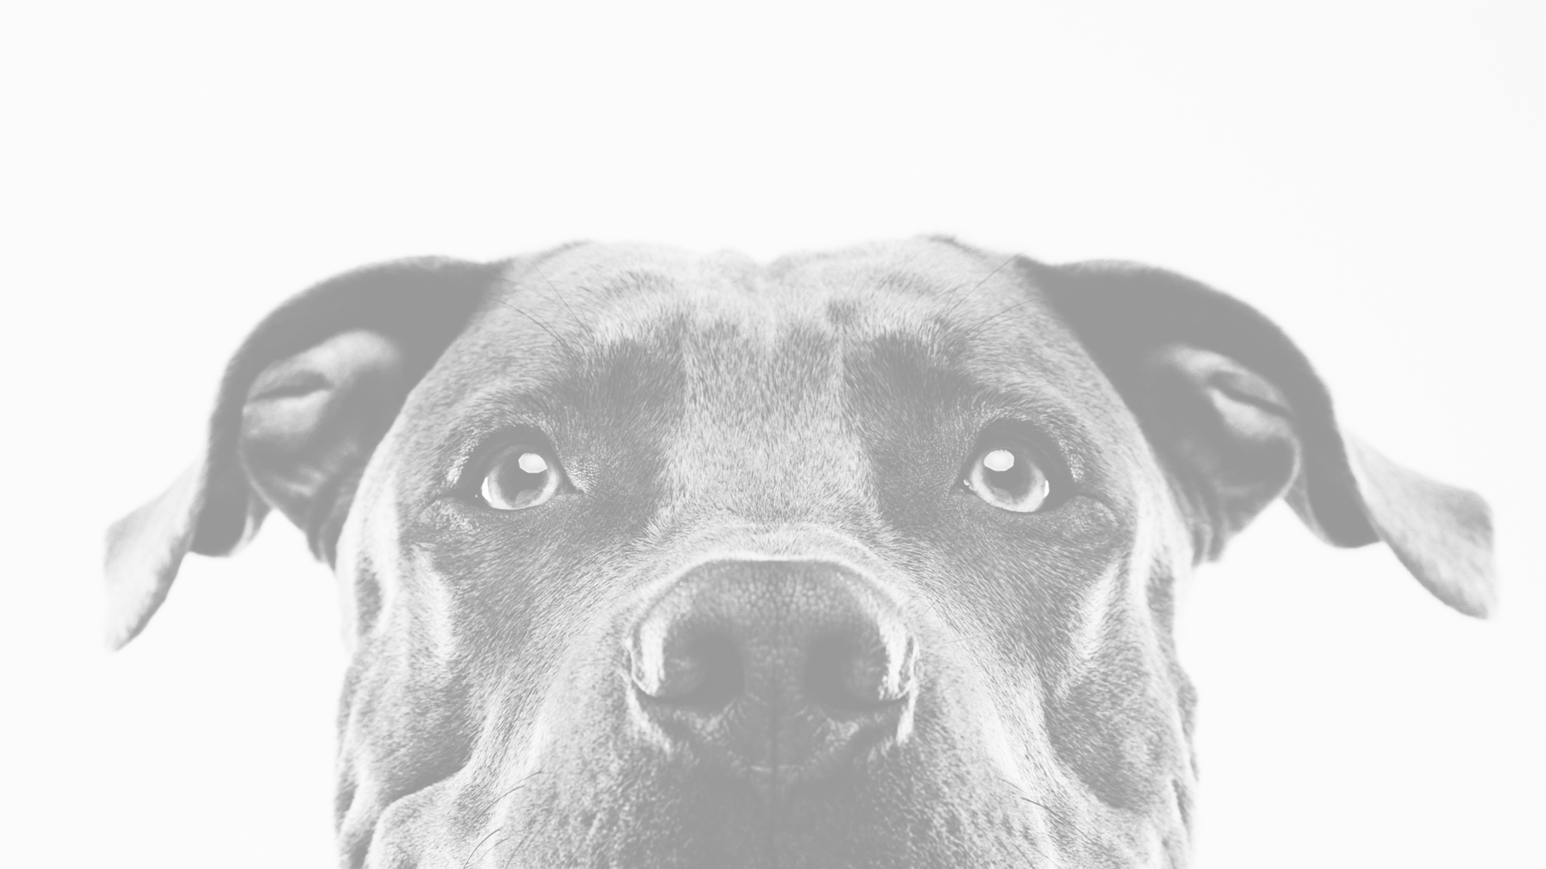

Puppy Love
Tera Brown
Latuanja Carson
Jessica Ferguson
Desiree Stout

Slide 2
Elevator Pitch
As a group of paw loving people, we thought "what better way to join two of peoples favorite pastimes: looking at pictures of furry friends and swiping"! Whether you are trying to determine what types of dogs you would be interested in adding to your family or just want to relax by looking through dog photos, this app is for you! With our App you can swipe right to save the image and left to not. You never have to worry about rejection like SOME OTHER apps, these furry friends love everyone! Check out our landing page to scope out some adoptable pups.

Slide 3
Concept
Description: An app that matches pups to their people.
Motivation for Development: A fun way for people to see what breeds/dogs they want to adopt.
User Story:
As a soon to be dog-parent
I want a find cute pics of pups
So that I know what breed to adopt

Slide 4
Process
Technologies Used:
node
API
Bootstrap
JSON
Mongo/MongoDB
Hammer.js
React.js
Tasks/Roles:
Teamwork
Pseudocode
Layout
Challenges:
React
Asynchronous API Calls
Hammer.js
Redirecting Loops
New API didn’t work
Unable to implement all desired features
Successes:
Teamwork
Adaptability
Planning

Slide 5
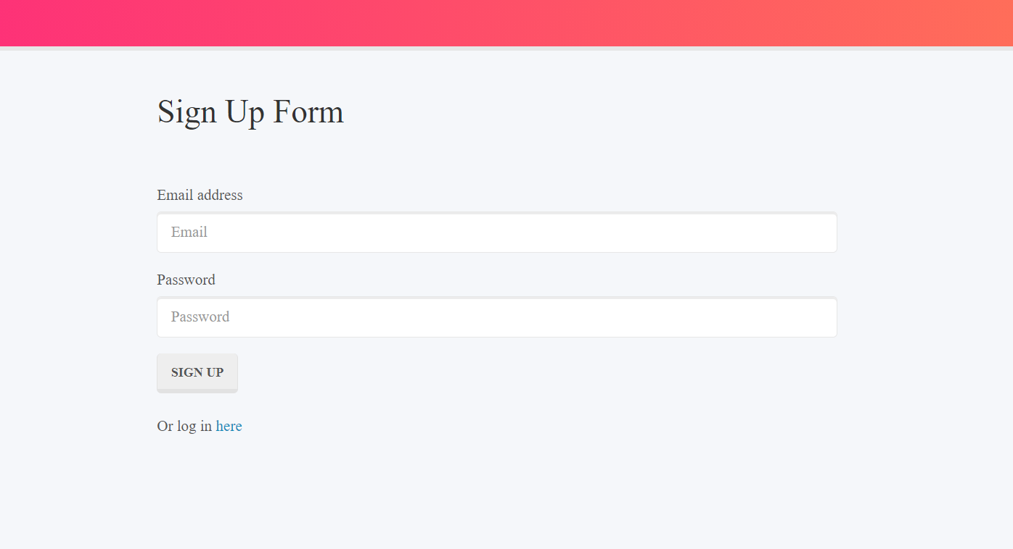
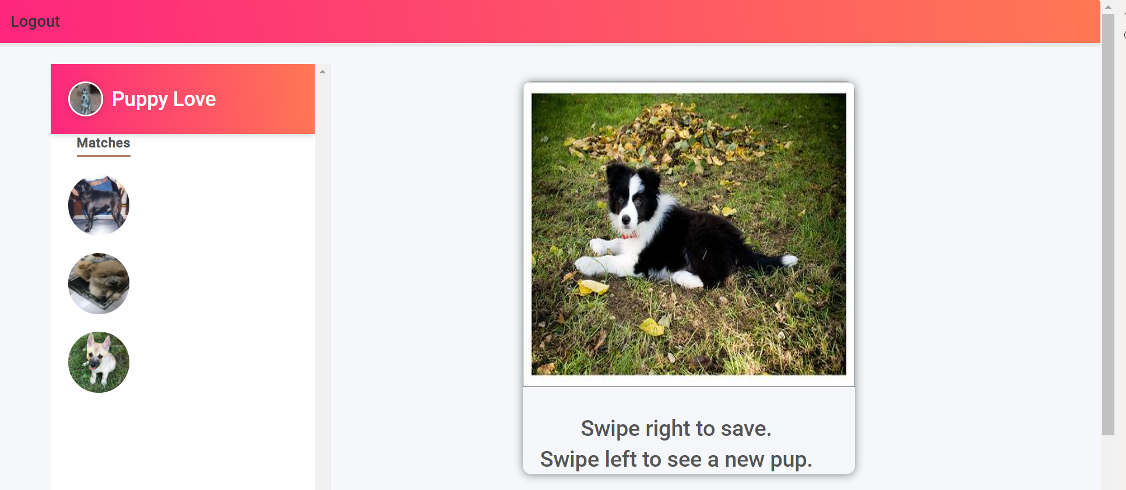
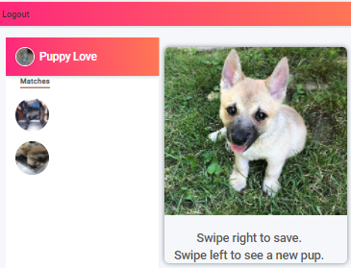
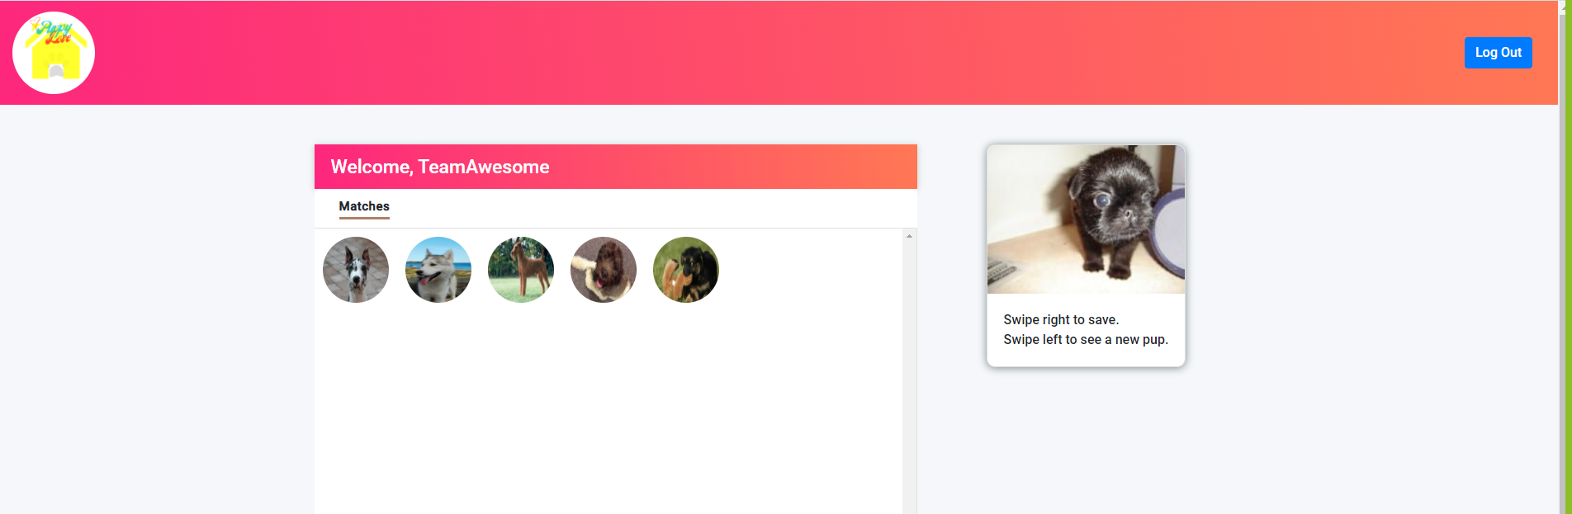
Demo

Slide 6
Directions for Future Development
YouTube results for recommended breed
Aggression or breed filter
Recommended care instructions for each breed
Customizable user preferences after initial setting
Save user posts/notes
Delete/Edit saved matches
Use a new API that links to adoptable pets

Slide 7
Links to Find Puppy Love
Deployed Site - https://descoding.github.io/PuppyLove
GitHub Repo - https://github.com/DesCoding/PuppyLove4.0

